Slide 1
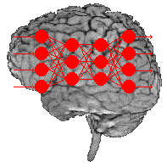
Neural Networks & Deep Learning
Dr. T. Hitendra Sarma
Associate Professor, Department of IT, Vasavi College of Engineering

Slide 2
Agenda
History of Artificial Neural Networks
What is an Artificial Neural Networks?
How it works?
Learning
  Learning paradigms
    Supervised learning
    Unsupervised learning
    Reinforcement learning
    Applications areas
    Advantages/ Disadvantages

Slide 3
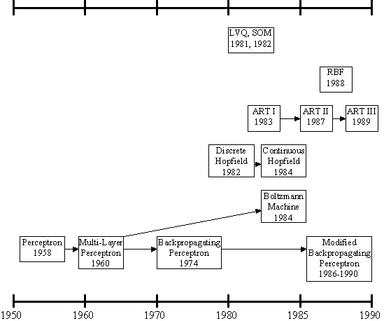
History of the Artificial Neural Networks
history of the ANNs stems from the 1940s, the decade of the first electronic computer.
However, the first important step took place in 1957 when Rosenblatt introduced the first concrete neural model, the perceptron. Rosenblatt also took part in constructing the first successful neurocomputer, the Mark I Perceptron. After this, the development of ANNs has proceeded as described in Figure.

Slide 4
History of the Artificial Neural Networks
Rosenblatt's original perceptron model contained only one layer. From this, a multi-layered model was derived in 1960. At first, the use of the multi-layer perceptron (MLP) was complicated by the lack of a appropriate learning algorithm.
In 1974, Werbos came to introduce a so-called backpropagation algorithm for the three-layered perceptron network.

Slide 5
History of the Artificial Neural Networks
In 1986, The application area of the MLP networks remained rather limited until the breakthrough when a general back propagation algorithm for a multi-layered perceptron was introduced by Rummelhart and Mclelland.
In 1982, Hopfield brought out his idea of a neural network. Unlike the neurons in MLP, the Hopfield network consists of only one layer whose neurons are fully connected with each other.

Slide 6
History of the Artificial Neural Networks
Since then, new versions of the Hopfield network have been developed. The Boltzmann machine has been influenced by both the Hopfield network and the MLP.

Slide 7
History of the Artificial Neural Networks
In 1988, Radial Basis Function (RBF) networks were first introduced by Broomhead & Lowe. Although the basic idea of RBF was developed 30 years ago under the name method of potential function, the work by Broomhead & Lowe opened a new frontier in the neural network community.

Slide 8
History of the Artificial Neural Networks
In 1982, A totally unique kind of network model is the Self-Organizing Map (SOM) introduced by Kohonen. SOM is a certain kind of topological map which organizes itself based on the input patterns that it is trained with. The SOM originated from the LVQ (Learning Vector Quantization) network the underlying idea of which was also Kohonen's in 1972.

Slide 9
History of Artificial Neural Networks
Since then, research on artificial neural networks has remained active, leading to many new network types, as well as hybrid algorithms and hardware for neural information processing.

Slide 10
Artificial Neural Network
An artificial neural network consists of a pool of simple processing units which communicate by sending signals to each other over a large number of weighted connections.

Slide 11
Artificial Neural Network
A set of major aspects of a parallel distributed model include:
  a set of processing units (cells).
  a state of activation for every unit, which equivalent to the output of the unit.
  connections between the units. Generally each connection is defined by a weight.
  a propagation rule, which determines the effective input of a unit from its external inputs.
  an activation function, which determines the new level of activation based on the effective input and the current activation.
  an external input for each unit.
  a method for information gathering (the learning rule).
  an environment within which the system must operate, providing input signals and _ if necessary _ error signals.

Slide 12
Why Artificial Neural Networks?
There are two basic reasons why we are interested in building artificial neural networks (ANNs):
Technical viewpoint: Some problems such as
character recognition or the prediction of future
states of a system require massively parallel and
adaptive processing.
Biological viewpoint: ANNs can be used to
replicate and simulate components of the human
(or animal) brain, thereby giving us insight into
natural information processing.

Slide 13
Artificial Neural Networks
The “building blocks” of neural networks are the neurons.
  In technical systems, we also refer to them as units or nodes.
Basically, each neuron
  receives input from many other neurons.
  changes its internal state (activation) based on the current input.
  sends one output signal to many other neurons, possibly including its input neurons (recurrent network).

Slide 14
Artificial Neural Networks
Information is transmitted as a series of electric impulses, so-called spikes.
The frequency and phase of these spikes encodes the information.
In biological systems, one neuron can be connected to as many as 10,000 other neurons.
Usually, a neuron receives its information from other neurons in a confined area, its so-called receptive field.

Slide 15
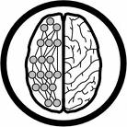
How do ANNs work?
An artificial neural network (ANN) is either a hardware implementation or a computer program which strives to simulate the information processing capabilities of its biological exemplar. ANNs are typically composed of a great number of interconnected artificial neurons. The artificial neurons are simplified models of their biological counterparts.
ANN is a technique for solving problems by constructing software that works like our brains.

Slide 16
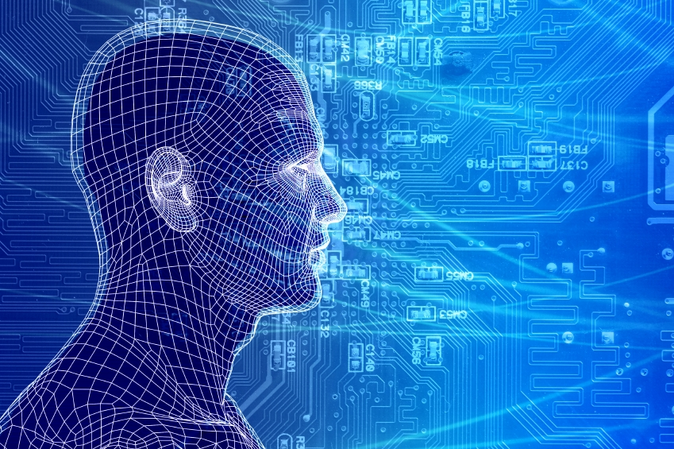
How do our brains work?
    The Brain is A massively parallel information processing system.
    Our brains are a huge network of processing elements. A typical brain contains a network of 10 billion neurons.

Slide 17
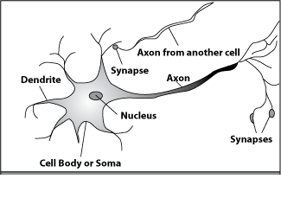
How do our brains work?
A processing element
Dendrites: Input
Cell body: Processor
Synaptic: Link
Axon: Output

Slide 18
How do our brains work?
A processing element
A neuron is connected to other neurons through about 10,000 synapses

Slide 19
How do our brains work?
A processing element
A neuron receives input from other neurons. Inputs are combined.

Slide 20
How do our brains work?
A processing element
Once input exceeds a critical level, the neuron discharges a spike ‐ an electrical pulse that travels from the body, down the axon, to the next neuron(s)

Slide 21
How do our brains work?
A processing element
The axon endings almost touch the dendrites or cell body of the next neuron.

Slide 22
How do our brains work?
A processing element
Transmission of an electrical signal from one neuron to the next is effected by neurotransmitters.

Slide 23
How do our brains work?
A processing element
Neurotransmitters are chemicals which are released from the first neuron and which bind to the
Second.

Slide 24
How do our brains work?
A processing element
This link is called a synapse. The strength of the signal that reaches the next neuron depends on factors such as the amount of neurotransmitter available.

Slide 25
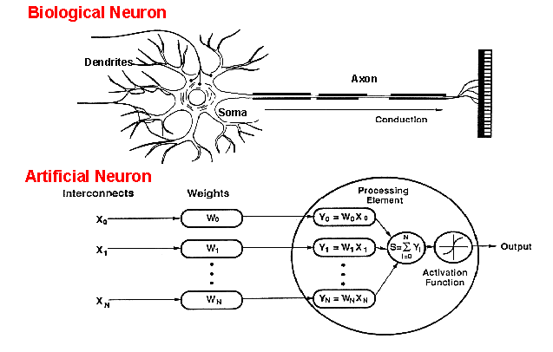
How do ANNs work?
An artificial neuron is an imitation of a human neuron

Slide 26
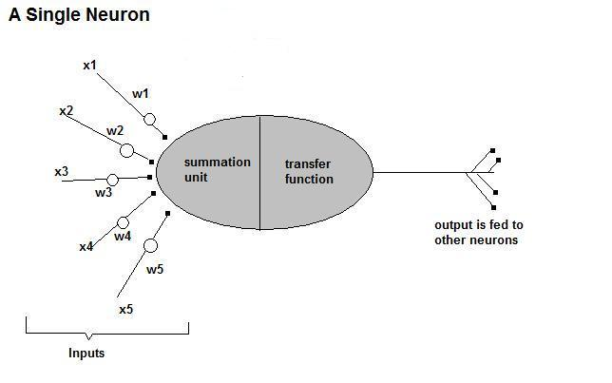
How do ANNs work?
• Now, let us have a look at the model of an artificial neuron.

Slide 27
How do ANNs work?
Input
xm
. . . . . . . . . . . .
x2
x1
Processing
∑
∑= X₁+X₂ + ….+X_{m} =y
Output
y

Slide 28

How do ANNs work?
Not all inputs are equal
xm
. . . . . . . . . . . .
x2
x1
Input
w_{m}
w₂
w₁
weights
. . . . .
Processing
∑
∑= X₁w₁+X₂w₂ + ….+X_{m}w_{m} =y
Output
y

Slide 29

How do ANNs work?
The signal is not passed down to the
next neuron verbatim
xm
. . . . . . . . . . . .
x2
x1
Input
w_{m}
w₂
w₁
weights
. . . . .
Processing
∑
Transfer Function (Activation Function)
f(v_{k})
Output
y

Slide 30
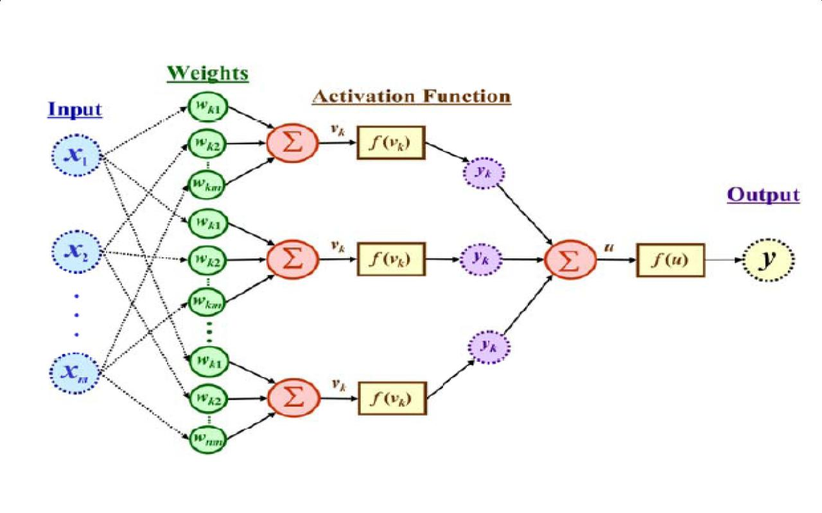
The output is a function of the input, that is affected by the weights, and the transfer functions

Slide 31
Artificial Neural Networks
An ANN can:
  compute any computable function, by the appropriate selection of the network topology and weights values.
  learn from experience!
  Specifically, by trial‐and‐error

Slide 32
Learning by trial‐and‐error
Continuous process of:
  Trial:
  Processing an input to produce an output (In terms of ANN: Compute the output function of a given input)
  Evaluate:
Evaluating this output by comparing the actual output with the expected output.
  Adjust:
  Adjust the weights.

Slide 33
How it works?
Set initial values of the weights randomly.
Input: truth table of the XOR
Do
Read input (e.g. 0, and 0)
Compute an output (e.g. 0.60543)
Compare it to the expected output. (Diff= 0.60543)
Modify the weights accordingly.
Loop until a condition is met
Condition: certain number of iterations
Condition: error threshold

Slide 34
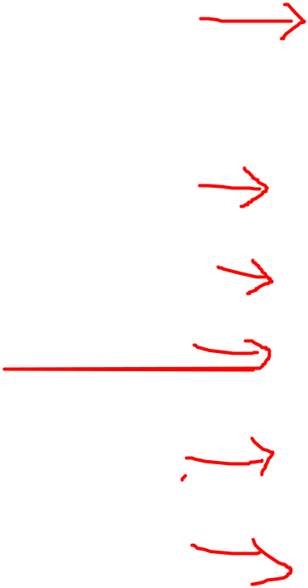
Design Issues
Initial weights (small random values ∈[‐1,1])
Transfer function (How the inputs and the weights are combined to produce output?)
Error estimation
Weights adjusting
Number of neurons
Data representation
Size of training set

Slide 35
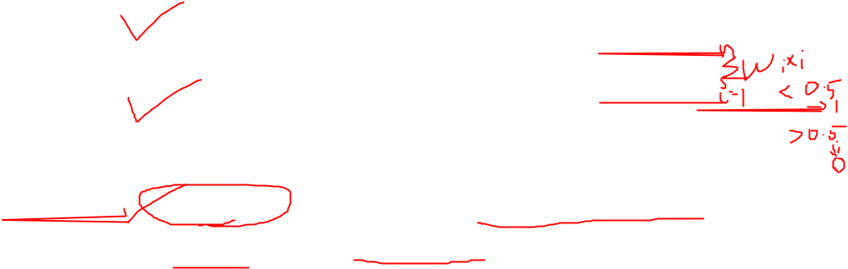
Transfer Functions
Linear: The output is proportional to the total weighted input.
Threshold: The output is set at one of two values, depending on whether the total weighted input is greater than or less than some threshold value.
Non‐linear: The output varies continuously but not linearly as the input changes.

Slide 36
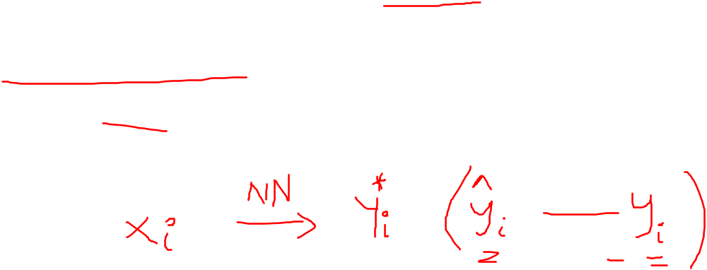
Error Estimation
The root mean square error (RMSE) is a frequently-used measure of the differences between values predicted by a model or an estimator and the values actually observed from the thing being modeled or estimated

Slide 37
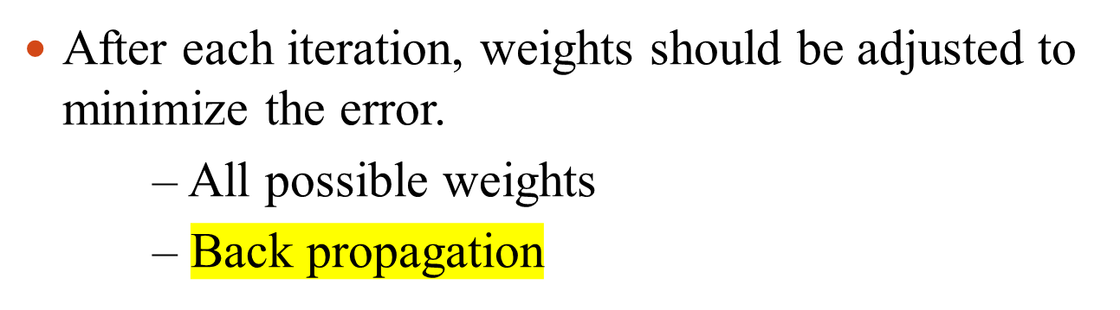
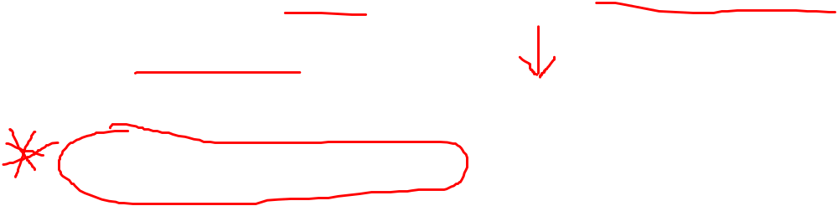
Weights Adjusting

Slide 38
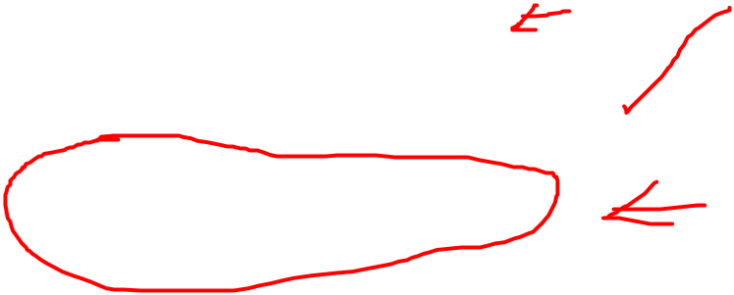
Number of neurons
Many neurons:
  Higher accuracy
  Slower
  Risk of over‐fitting
    Memorizing, rather than understanding
    The network will be useless with new problems.
Few neurons:
  Lower accuracy
  Inability to learn at all
Optimal number.

Slide 39
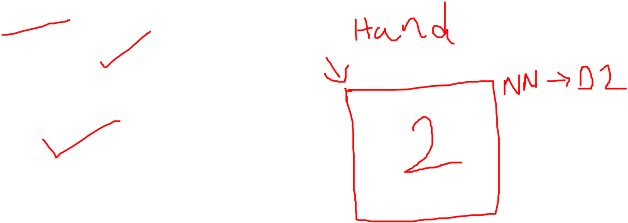
Data representation
Usually input/output data needs pre‐processing
Pictures
  Pixel intensity
Text:
  A pattern

Slide 40

Size of training set
No one‐fits‐all formula
Over fitting can occur if a “good” training set is not chosen
What constitutes a “good” training set?
  Samples must represent the general population.
  Samples must contain members of each class.
  Samples in each class must contain a wide range of variations or noise effect.
The size of the training set is related to the number of hidden neurons

Slide 41
Learning Paradigms
Supervised learning
Unsupervised learning
Reinforcement learning

Slide 42
Supervised learning
This is what we have seen so far!
A network is fed with a set of training samples (inputs and corresponding output), and it uses these samples to learn the general relationship between the inputs and the outputs.
This relationship is represented by the values of the weights of the trained network.

Slide 43
Unsupervised learning
No desired output is associated with the training data!
Faster than supervised learning
Used to find out structures within data:
  Clustering
  Compression

Slide 44
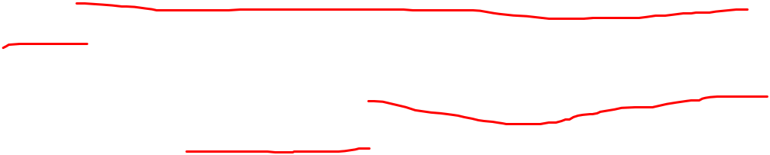
Reinforcement learning
Like supervised learning, but:
  Weights adjusting is not directly related to the error value.
  The error value is used to randomly, shuffle weights!
  Relatively slow learning due to ‘randomness’.

Slide 45

Applications Areas
Function approximation
  including time series prediction and modeling.
Classification
  including patterns and sequences recognition, novelty detection and sequential decision making.
    (radar systems, face identification, handwritten text recognition)
Data processing
  including filtering, clustering blinds source separation and compression.
    (data mining, e-mail Spam filtering)

Slide 46

Advantages / Disadvantages
Advantages
  Adapt to unknown situations
  Powerful, it can model complex functions.
  Ease of use, learns by example, and very little user domain‐specific expertise needed
Disadvantages
  Forgets
  Not exact
  Large complexity of the network structure

Slide 47
Conclusion
Artificial Neural Networks are an imitation of the biological neural networks, but much simpler ones.
The computing would have a lot to gain from neural networks. Their ability to learn by example makes them very flexible and powerful furthermore there is need to device an algorithm in order to perform a specific task.

Slide 48
Conclusion
Neural networks also contributes to area of research such a neurology and psychology. They are regularly used to model parts of living organizations and to investigate the internal mechanisms of the brain.
Many factors affect the performance of ANNs, such as the transfer functions, size of training sample, network topology, weights adjusting algorithm, …

Slide 49
Thank You

